Slide 1
Structural Model

Slide 2
Structural Models
Structural models of software display the organization of a system in terms of the components that make up that system and their relationships.
Structural models may be
Static Models : structure of the system design
Dynamic Models: organization of the system when executing
You create structural models of a system when you are discussing and designing the system architecture.

Slide 3

Class Diagrams
Class diagrams in UML can be expressed at different level of detail.
At the first stage of developing a model,
Look at the world and identify the essential objects and represent them as class.
The simplest way is to write the name of the class in a box

Slide 4


Class Diagrams
At the Second stage of developing a model,
You can also note the existence of an association by drawing a line between the classes
Naming Associations Every association needs a name, an active verb that describes the relationship of one class to another class, such as "owns" or "opens."
Owns

Slide 5

Class Diagrams
At the Second stage of developing a model,
Multiplicity Associations : A number of objects of each class may be associated. For example, a customer may open many accounts, and an order may include many items. The number of participating objects is called the multiplicity, and it must be set for each end of the association.
The notation for multiplicity is as follows:
Asterisk (*) when used alone means zero or more, no lower or upper limit.
Asterisk (*) when used in a range (1..*) means no upper limit.
Values separated by two periods (..) mean a range.
Values separated by commas mean an enumerated list of values.
Owns

Slide 6
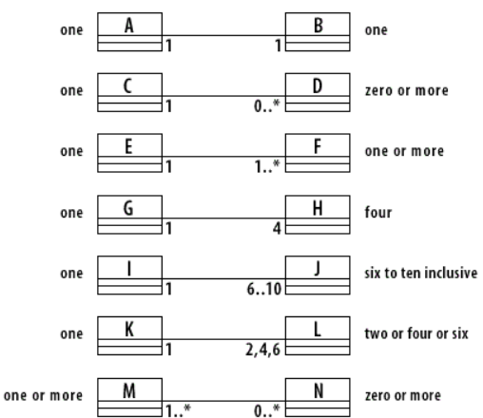
Class Diagrams

Slide 7
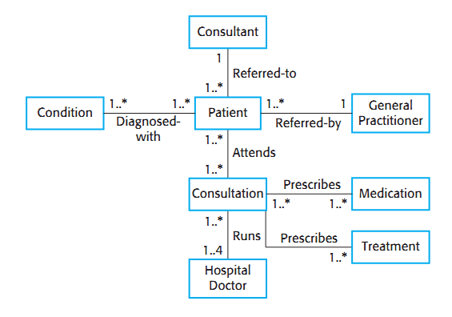
Classes and associations in the MHC-PMS

Slide 8
Classes and associations in the MHC-PMS
Entities (Classes) and Their Relationships:
Patient
Central to the diagram.
Diagnosed-with → Multiple conditions (1..* on both sides): Each patient has one or more conditions; each condition is associated with one or more patients.
Referred-by ← 1 General Practitioner: A patient is referred by one general practitioner (GP), and each GP can refer multiple patients.
Referred-to → 1 Consultant: A patient is referred to exactly one consultant; each consultant can have many referred patients.
Attends → Consultations (1..*): A patient attends one or more consultations.
Consultation
Prescribes → Medication (1..* on both sides): Each consultation can result in one or more medications being prescribed; each medication can be prescribed in multiple consultations.
Prescribes → Treatment (1..* on both sides): Similar to medications, multiple treatments can be prescribed.
Runs ← 1 to 4 Hospital Doctors: A consultation is run by 1 to 4 hospital doctors, and each hospital doctor can run multiple consultations.

Slide 9
Classes and associations in the MHC-PMS
Entities (Classes) and Their Relationships:
Hospital Doctor
Associated with consultations through the "Runs" relationship.
General Practitioner
Refers patients (1 to many relationship).
Consultant
Patients are referred to consultants (1 to many relationship).
Condition
Associated with patients via "Diagnosed-with".
Medication and Treatment
Both are prescribed in consultations (many-to-many relationships).
Cardinalities Summary:
1..*: One or more.
1: Exactly one.
1..4: Between one and four

Slide 10
Class Diagrams
The main elements of a class diagram are boxes, which are the icons used to represent classes and interfaces. Each box is divided into horizontal parts.
The top part contains the name of the class.
The middle section lists the attributes of the class. Attributes can be values that the class can compute from its instance variables or values that the class can get from other objects of which it is composed.

Slide 11
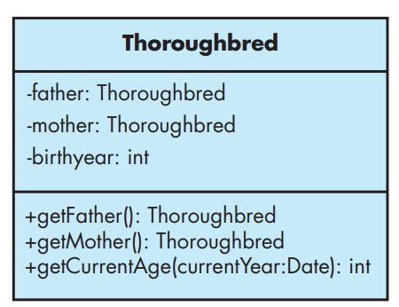
Class Diagrams
The third section of the class diagram contains the operations or behaviors of the class. An operation refers to what objects of the class can do. It is usually implemented as a method of the class.
FIGURE A1.1

Slide 12
Class Diagrams
Figure A1.1 presents a simple example of a Thoroughbred class that models thoroughbred horses.
It has three attributes displayed— mother, father, and birth year.
The diagram also shows three operations: getCurrentAge(), getFather(), and getMother().
There may be other suppressed attributes and operations not shown in the diagram.
Each attribute can have a name, a type, and a level of visibility. The type and visibility are optional. The type follows the name and is separated from the name by a colon.

Slide 13
Class Diagrams
The visibility is indicated by a preceding –, #, ~, or +, indicating, respectively, private, protected, package, or public visibility.
In Figure A1.1, all attributes have private visibility, as indicated by the leading minus sign (–).
You can also specify that an attribute is a static or class attribute by underlining it. Each operation can also be displayed with a level of visibility, parameters with names and types, and a return type.

Slide 14
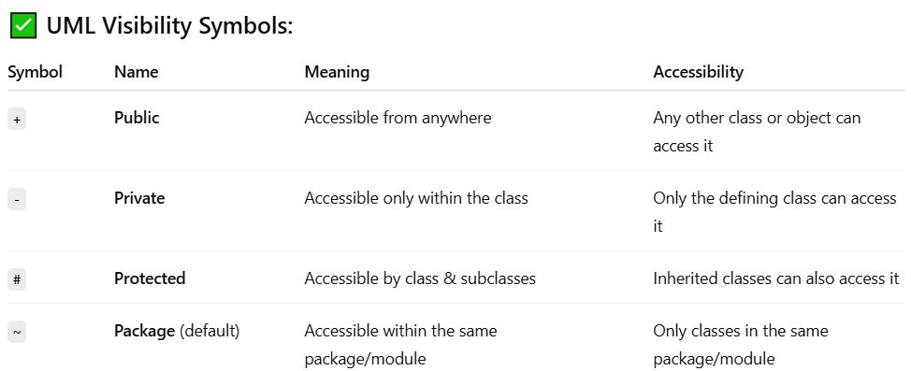
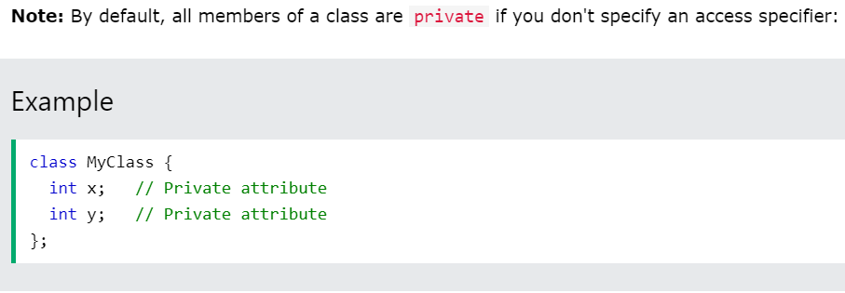
Class Diagrams

Slide 15
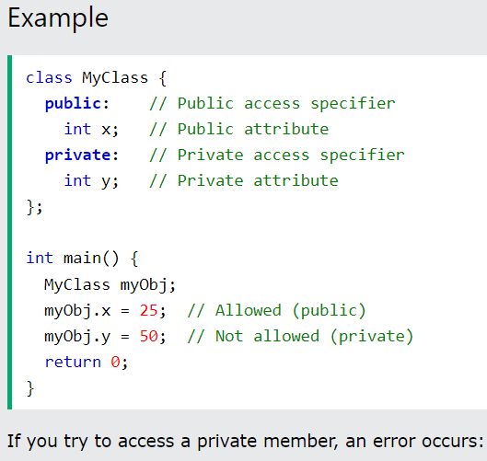
Class Diagrams

Slide 16
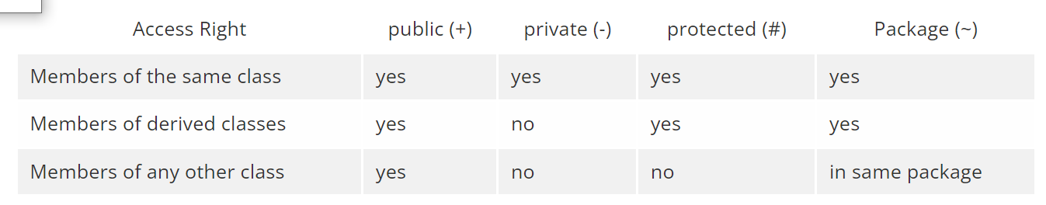
Class Diagrams

Slide 17
Class Diagrams
An abstract class or abstract method is indicated by the use of italics for the name in the class diagram. See the Horse class in Figure A1.2 for an example.
An interface is indicated by adding the phrase “«interface»” (called a stereotype ) above the name. See the OwnedObject interface in Figure A1.2.
An interface can also be represented graphically by a hollow circle.

Slide 18
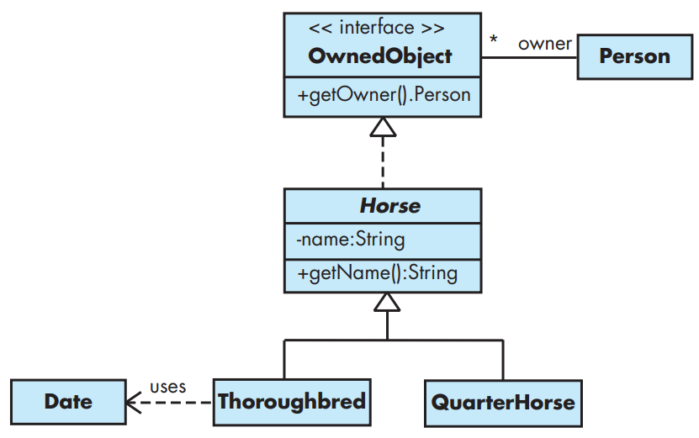
Class Diagrams
FIGURE A1.2

Slide 19
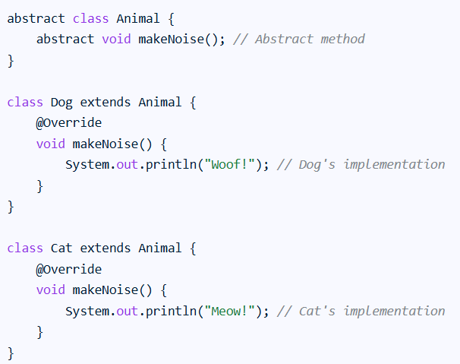
Class Diagrams

Slide 20
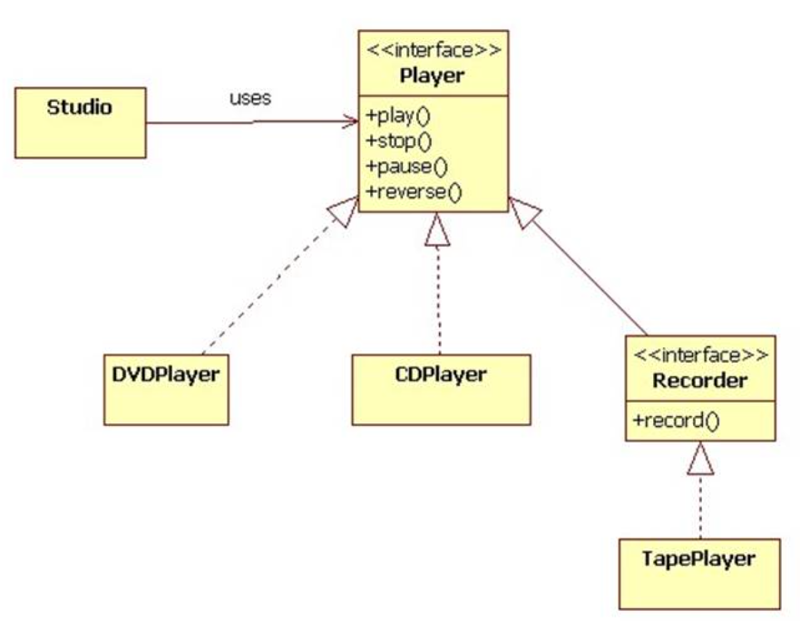
Class Diagrams: interfaces

Slide 21
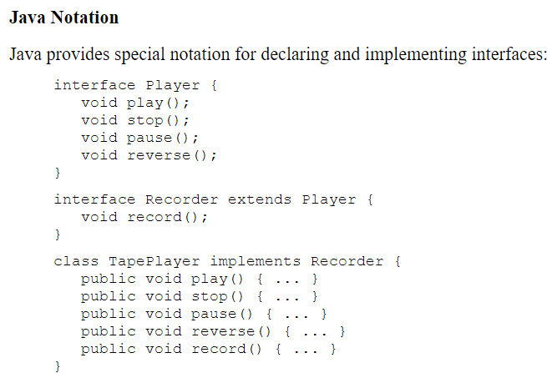
Class Diagrams

Slide 22
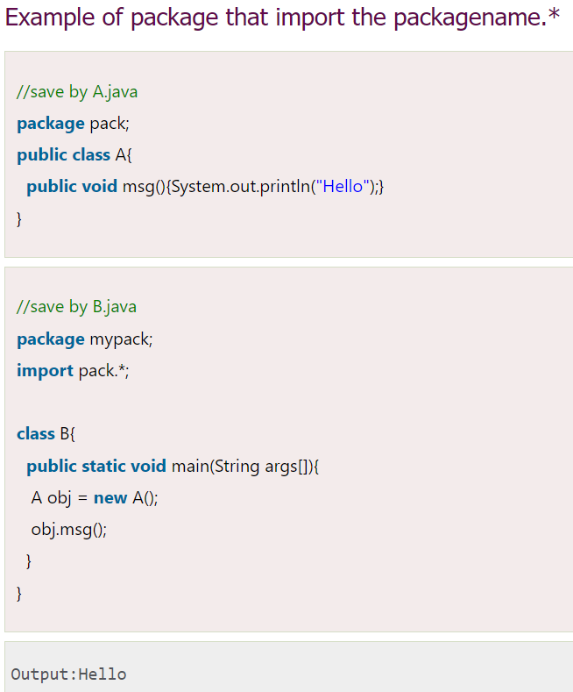
Class Diagrams

Slide 23
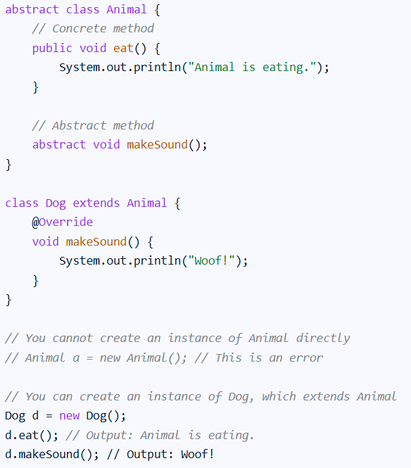
Class Diagrams an example of abstract class in java

Slide 24
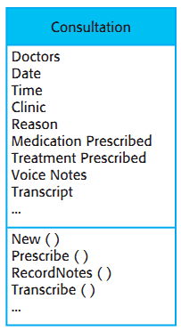
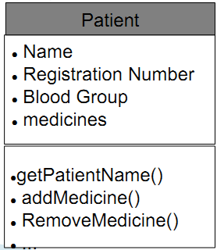
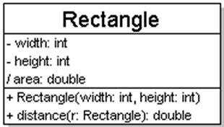
Adding details to class diagram
attributes (fields, instance variables)
visibility:
+ public, # protected, - private,~ package (default), / derived

Slide 25
Relationships between classes
Generalization: an inheritance relationship
inheritance between classes
interface implementation
Association: a usage relationship
dependency
aggregation
composition

Slide 26
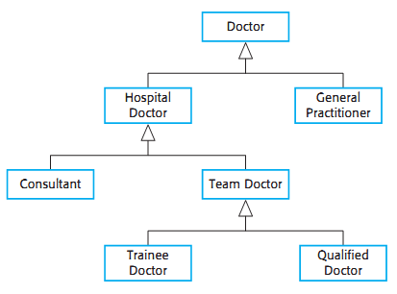
Generalization (inheritance) relationships
Hierarchies drawn top-down
arrows point upward to parent
line/arrow styles indicate whether parent is a(n):
class: solid line, black arrow

Slide 27
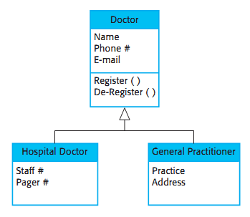
Generalization (inheritance) relationships

Slide 28
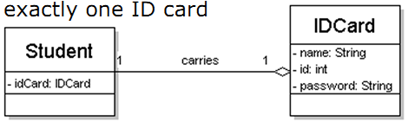
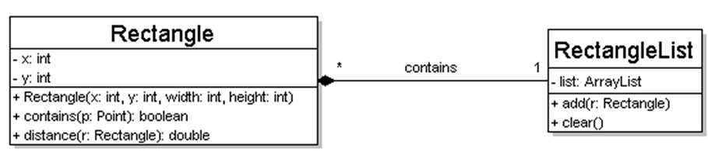
Multiplicity of associations
one-to-one
each student must carry exactly one ID card
one-to-many
one rectangle list can contain many rectangles

Slide 29
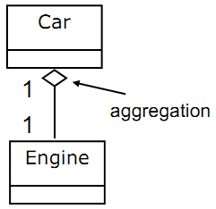
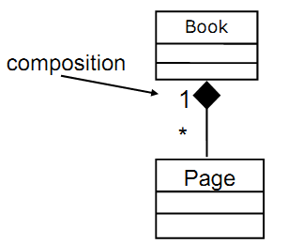
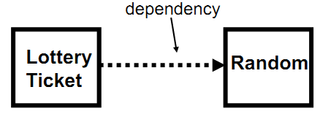
Association types
Aggregation: “is part of”
symbolized by a clear white diamond
Composition: “is entirely made of”
stronger version of aggregation
the parts live and die with the whole
symbolized by a black diamond
Dependency: “uses temporarily”
symbolized by dotted line
often is an implementation detail, not an intrinsic part of that object's state

Slide 30
Association types: Dependency
In a class diagram (used in UML – Unified Modeling Language), a dependency represents a relationship between two classes where one class depends on another. This means that a change in the supplier class may affect the client class.
Key Points:
Dependency is a weak relationship.
It shows that one class uses another class, usually as a parameter or local variable.
It is represented by a dashed arrow pointing from the dependent (client) class to the independent (supplier) class.
It is often used to show "uses", "calls", or "creates" relationships.
Example:
If Class A uses Class B inside one of its methods (e.g., it creates an object of Class B or calls a method of Class B), then Class A depends on Class B.

Slide 31
Association types: Dependency
class CreditCard
{
void authorize(double amount)
{
System.out.println("Authorized payment of $" + amount);
}
}
class PaymentService
{
void makePayment(CreditCard card, double amount)
{
// Temporary use of CreditCard object
card.authorize(amount);
}
}

Slide 32
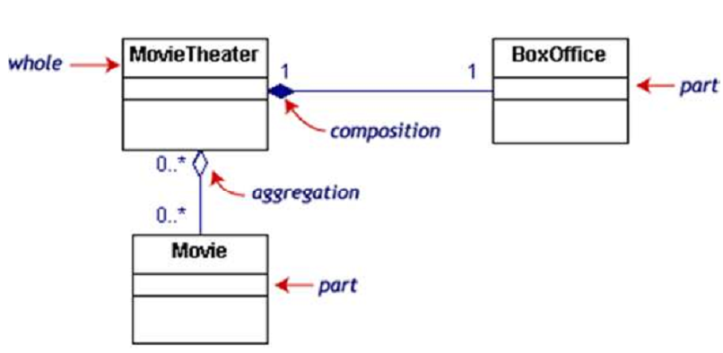
Association types
If the movie theater goes away
so does the box office => composition
but movies may still exist => aggregation

Slide 33
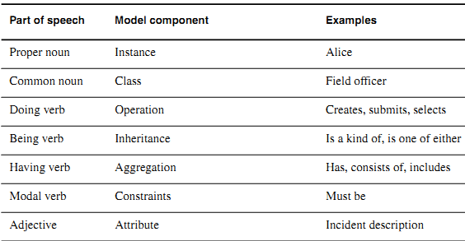
Identifying Analysis Classes

Slide 34
Identifying Classes
Classes are found in following forms:
External entities: The system, people or the device generates the information that is used by the computer-based system.
Things: The reports, displays, letter, signal are the part of the information domain or the problem.
Occurrences or events: A property transfer or the completion of a series or robot movements occurs in the context of the system operation.
Roles: The people like manager, engineer, salesperson are interacting with the system.
Organizational units: The division, group, team are suitable for an application.
Places: The manufacturing floor or loading dock from the context of the problem and the overall function of the system.
Structures: The sensors, computers are defined a class of objects or related classes of objects.

Slide 35
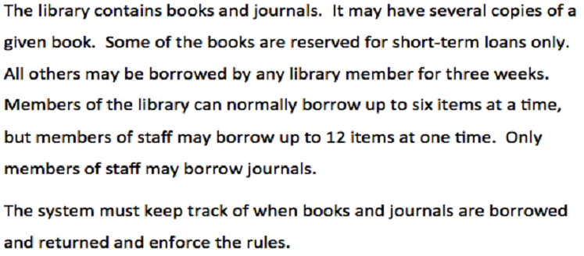
Noun Identification :A Library System

Slide 36
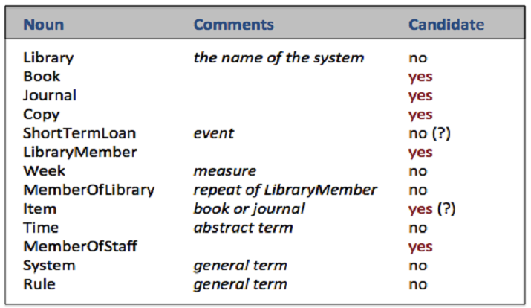
Candidate Classes

Slide 37
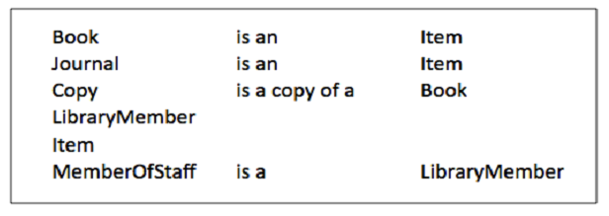
Candidate Classes

Slide 38
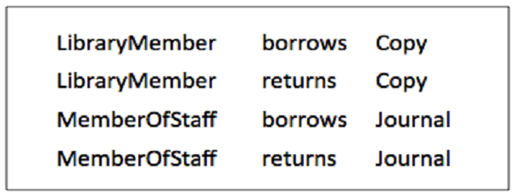
Methods

Slide 39
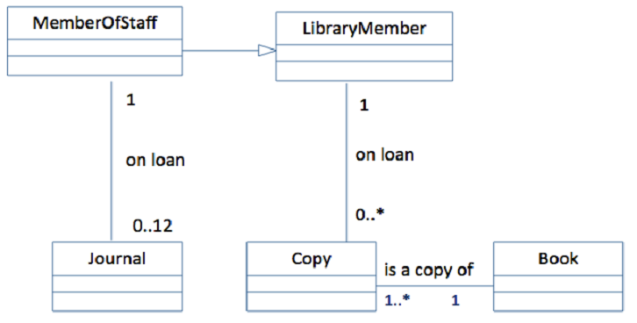
Possible Class Diagram

Slide 40
Class Diagrams
Scenario:
"A Student enrolls in many Courses. Each Student has a name, student ID, and email. Each Course has a course name, course code, and number of credits.“
Step 1: Find Nouns
Student
Courses
Name
Student ID
Email
Course name
Course code
Number of credits

Slide 41
Class Diagrams
Step 2: Identify Attributes for each main class
Student
name
student_id
email
Course
course_name
course_code
credits

Slide 42
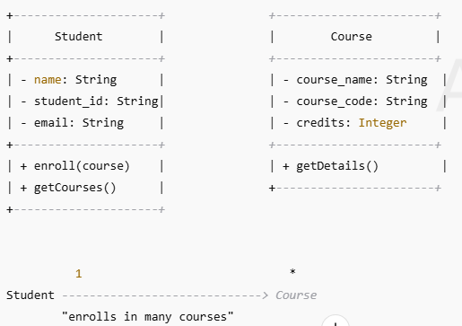
Class Diagrams

Slide 43
Class Diagrams
Class-based elements. Each usage scenario implies a set of objects that are manipulated as an actor interacts with the system.
These objects are categorized into classes: a collection of things that have similar attributes and common behaviors.
For example, a UML class diagram can be used to depict a Sensor class for the SafeHome security function ( Figure 8.4 ). Note that the diagram lists the attributes of sensors (e.g., name, type) and the operations (e.g., identify, enable) that can be applied to modify these attributes. In addition to class diagrams, other analysis modeling elements depict the manner in which classes collaborate with one another and the relationships and interactions between classes

Slide 44
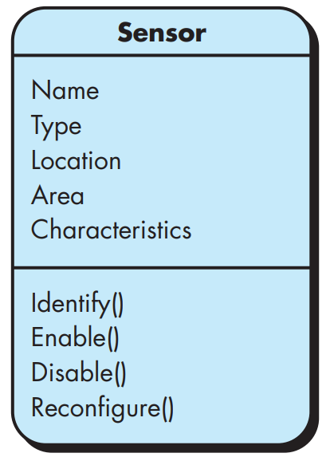
Class Diagrams

Slide 45
SPECIFYING ATTRIBUTES
Attributes describe a class that has been selected for inclusion in the analysis model. In essence, it is the attributes that define the class—that clarify what is meant by the class in the context of the problem space.
For example, if we were to build a system that tracks baseball statistics for professional baseball players, the attributes of the class Player would be quite different than the attributes of the same class when it is used in the context of the professional baseball pension system.
In the former, attributes such as name, position, batting average, fielding percentage, years played, and games played might be relevant (next slide).

Slide 46
SPECIFYING ATTRIBUTES
For the latter, some of these attributes would be meaningful, but others would be replaced (or augmented) by attributes like average salary, credit toward full vesting, pension plan options chosen, mailing address, and the like.
To develop a meaningful set of attributes for an analysis class, you should study each use case and select those “things” that reasonably “belong” to the class.
In addition, the following question should be answered for each class: What data items (composite and/or elementary) fully define this class in the context of the problem at hand?

Slide 47
Noun Identification
The SafeHome security function enables the homeowner to configure the security system when it is installed, monitors all sensors connected to the security system, and interacts with the homeowner through the Internet , a PC or a control panel .
During installation , the SafeHome PC is used to program and configure the system . Each sensor is assigned a number and type , a master password is programmed for arming and disarming the system, and telephone number(s) are input for dialing when a sensor event occurs.

Slide 48
Noun Identification
When a sensor event is recognized, the software invokes an audible alarm attached to the system. After a delay time that is specified by the homeowner during system configuration activities, the software dials a telephone number of a monitoring service, provides information about the location, reporting the nature of the event that has been detected. The telephone number will be redialed every 20 seconds until telephone connection is obtained.
The homeowner receives security information via a control panel, the PC, or a browser, collectively called an interface. The interface displays prompting messages and system status information on the control panel, the PC, or the browser window. Homeowner interaction takes the following form . . .

Slide 49
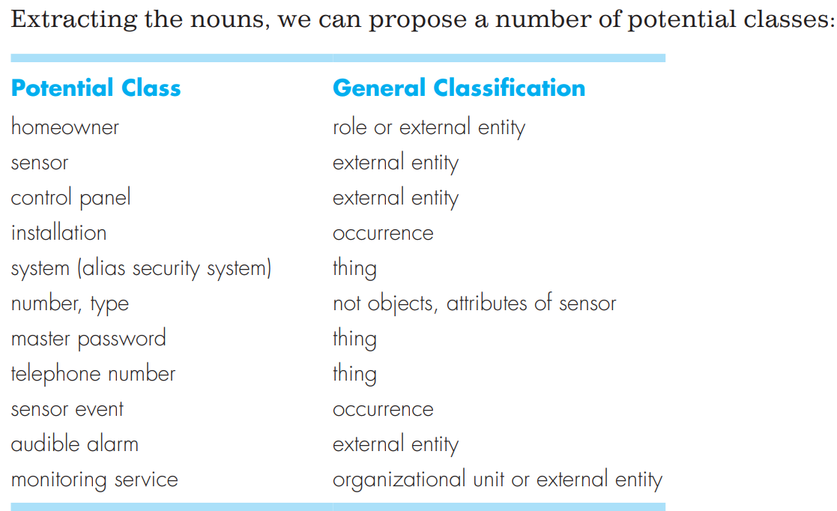
Noun Identification

Slide 50
Noun Identification
Coad and Yourdon [Coa91] suggest six selection characteristics that should be used as you consider each potential class for inclusion in the analysis model:
Retained information. The potential class will be useful during analysis only if information about it must be remembered so that the system can function.
Needed services. The potential class must have a set of identifiable operations that can change the value of its attributes in some way.
Multiple attributes. During requirement analysis, the focus should be on “major” information; a class with a single attribute may, in fact, be useful during design, but is probably better represented as an attribute of another class during the analysis activity.

Slide 51
Noun Identification
Common attributes. A set of attributes can be defined for the potential class and these attributes apply to all instances of the class.
Common operations. A set of operations can be defined for the potential class and these operations apply to all instances of the class.
Essential requirements. External entities that appear in the problem space and produce or consume information essential to the operation of any solution for the system will almost always be defined as classes in the requirements model.

Slide 52
Noun Identification
To be considered a legitimate class for inclusion in the requirements model, a potential object should satisfy all (or almost all) of these characteristics. The decision for inclusion of potential classes in the analysis model is somewhat subjective, and later evaluation may cause an object to be discarded or reinstated. However, the first step of class-based modeling is the definition of classes, and decisions (even subjective ones) must be made. With this in mind, you should apply the selection characteristics to the list of potential SafeHome classes:

Slide 53
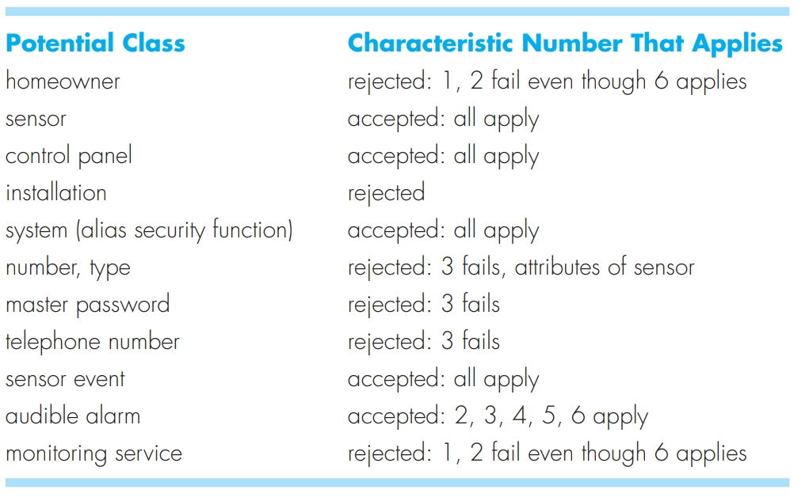
Noun Identification

